Slide 1
TrueTouch
Comprehensive Design Review
Team 19

Slide 2
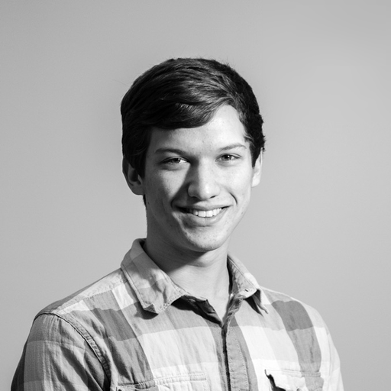
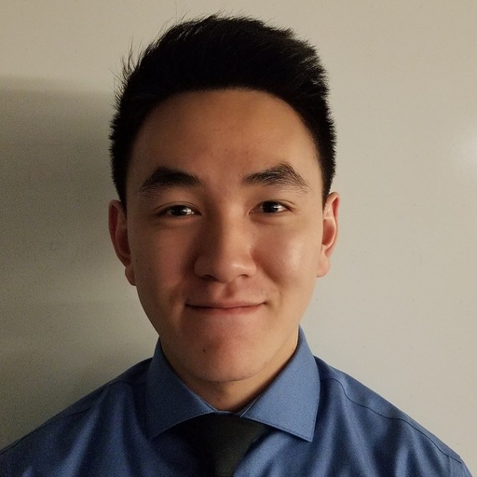
Our Team
Anthony Chan: EE
Alex Dickopf: CSE
Cameron Kluza: CSE
Jonathan Yip: CSE
Notes:
Alex

Slide 3
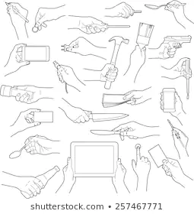
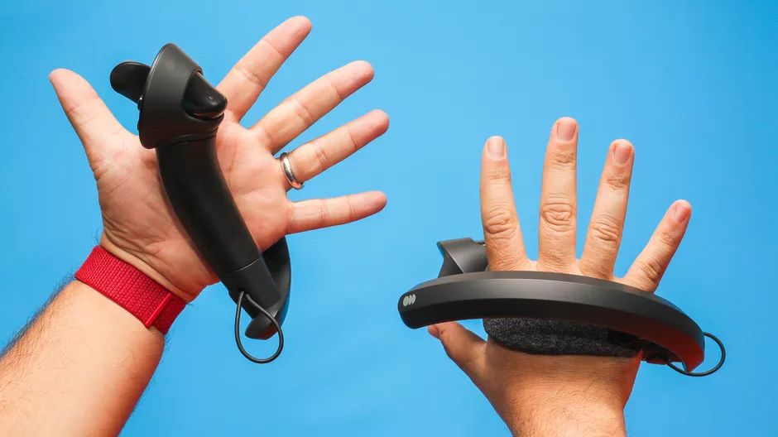
Problem Statement
VR lacks sensation of physical touch
Not realistic if your fingers can go through an object
Hand held controllers
Hand locked in a specific shape
Limited vibration areas
Improvement of immersion
Notes:
Highlight key aspects of problem statement
Alex
-lets review: our project focuses on vr
-while already immersive, it lacks immersion for touch
-we have controllers, but either limit or do not provide proper immersion
-begs the q: how to improve

Slide 4
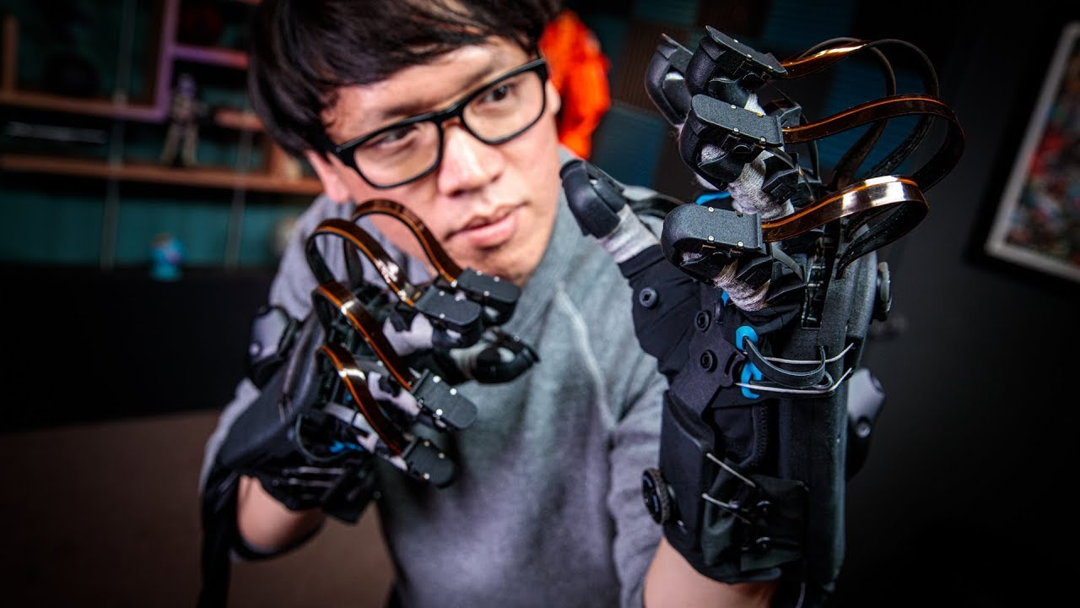
Haptic Feedback
Feedback to simulate physical touch
Different kinds of feedback
...such as force, vibrotactile, ...
Sense of impact and vibration
vibration motors (ERM, LRA, etc)
Sense of shape
Exoskeletons
Notes:
Note that most things on the market only provide vibration feedback
Mostly research and “upcoming” products for feeling shape
Very few solutions that do both
Alex
-answer: hf tech
-different kinds
-
Explain types of feedback when speaking about this slide

Slide 5
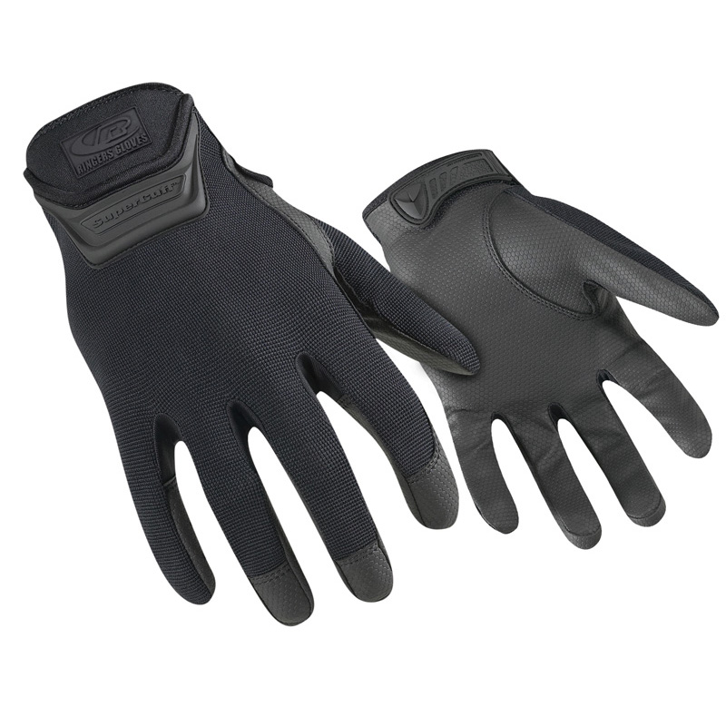
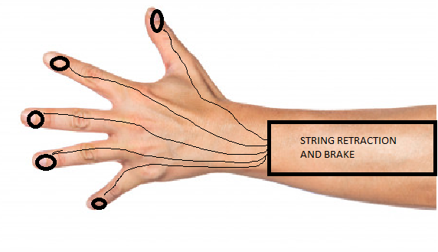
Proposed Solution: TrueTouch
Combining both: feeling of shape and impact
Controller free
Lightweight glove, extending onto the arm
Integrate with hand tracking
Ringer R507-09 Duty Gloves
Notes:
Jonathan
Ill review quickly what our proposed solution is. We wanted to create an accessory in the form of a glove so you could feel the shape and vibration of an object. Our system is composed of two different haptic feedback systems. One uses strings coming out of a housing on the forearm and the other are ERM motors. Everything is controlled with a microcontroller which is in the forearm mount

Slide 6
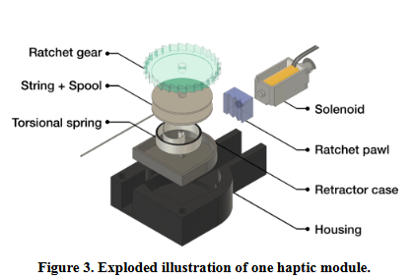
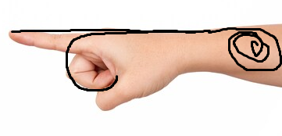
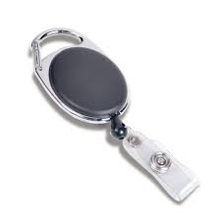
TrueTouch’s “Braking System”
System is mounted on the top of the forearm
Retractable string attached to the back of each fingertip
Length of the string attached to the back of the fingertips vary as you bend your finger
Limiting the length of a string along the back of your finger will limit how far you can bend
Using five ratchet and pawls to lock string length (inspired by Wireality)
Notes:
Jonathan
Our braking system is in charge of giving the feeling of shape. This subsystem consists of a forearm mount with strings coming out along the hand and finger. Inside that forearm mount, there are solenoids that extend into a gear stopping it. Which stops the string from extending and therefore your in
The strings coming out of the forearm housing are used to give the feeling of shape. When you grasp something, your fingers should not be able to go through the object. Solenoids in the forearm mount are used to lock the string at a certain length, restricting the finger from bending any further.

Slide 7
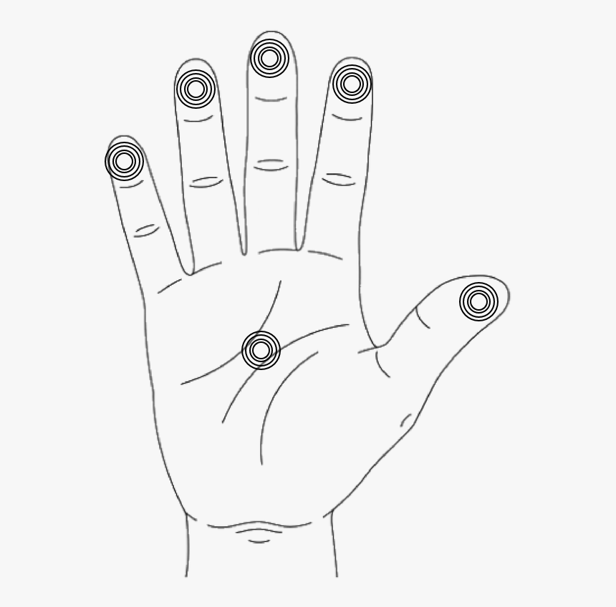
TrueTouch’s Vibrotactile System
Small Eccentric Rotating Mass (ERM) motors will provide vibrations, simulating impact
ERM motors will be placed on palm and each finger to provide sensation of impact against hand
Notes:
Jonathan
We have 6 ERM motors. One on the tip of each finger and one on the palm. These ERM motors are controlled by PWM so we can change the intensity of their vibrations. These will provide vibrations simulating the feeling of impact.

Slide 8
Requirements
Wireless system
Rechargeable battery of minimum 1 hour of life
Single glove with system weighs no more than 2lbs
Braking system and vibration activates within 100ms of seeing the object being touched in virtual world
Braking system able to withstand 20N of pulling force from finger-bending strength
Notes:
Jonathan
Here are our system requirements. We want our system to be wireless. This means that we will need a battery. We decided that 1 hour of battery life would be adequate. We want our glove to weigh no more than 2 lbs so it is unobtrusive while using it. The latency of the system must be within 100ms of seeing the interaction. Lastly, we want a robust system that will not break if a lot of force is applied to the strings. We decided that withstanding 20N of force would be enough.

Slide 9
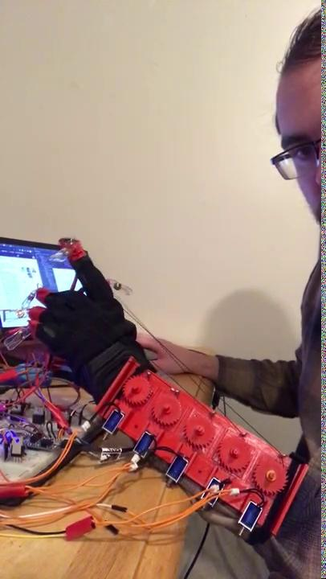
Demo from MDR
Notes:
Alex

Slide 10
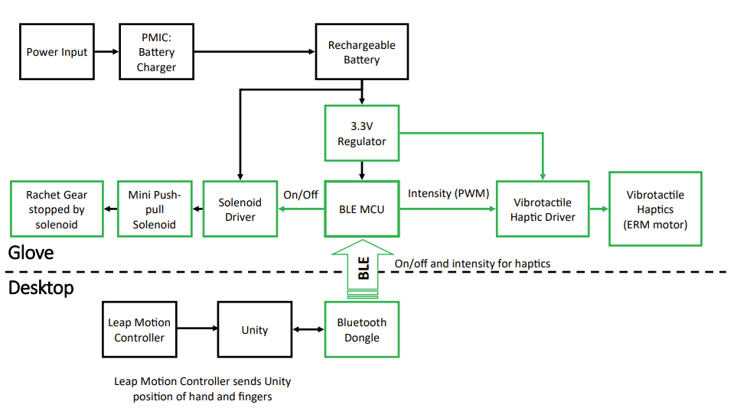
Hardware Diagram
Notes:
Anthony

Slide 11
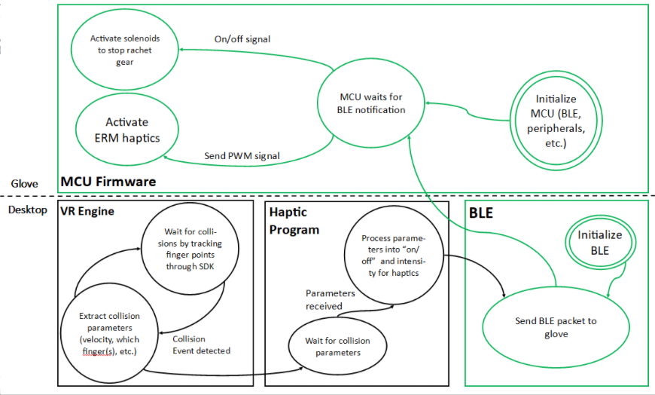
Software Diagram
Notes:
Anthony

Slide 12
CDR Deliverables
● We already have working glove hardware prototype on breadboard
○ Control solenoids and ERM with BLE through PC running Python
○ Prototype using our custom PCB + firmware
● Prototype that can show VR capabilities
● Custom PCB made and tested
● Finalized 3D print
Notes:
Cameron
Explain and justify any changes to this
VR -> leap motion:
hardware availability/compatibility issues
main idea of holding things in virtual world is the same, just different display
Python -> Unity scripts for BLE communications
Don’t go too fast, build off of previous slides to explain
What we’ve completed since MDR:
Hardware - we have PCBA
Battery
Leap motion on desktop-side
Software - Virtual world interactions
Unity environment
Detection and handling of collisions

Slide 13
Current Prototype-Hardware
Hardware prototype is assembled with development board
HTC Vive replaced with Leap Motion Controller
Parts List-Nordic nRF52, SparkFun ERM motors, Adafruit: Mini Push-Pull Solenoid
Notes:
Cameron

Slide 14
Current Prototype- Unity
Set up simple Unity Environment
Connected MCU to Unity through BLE
Unity can detect collisions. When collisions occur send message to MCU
Notes:
Cameron

Slide 15
Current Prototype- Arduino
Glove board sketch receives data from Adafruit BLE UART class
Handles commands to actuate solenoids and PWM ERMs
Notes:
Cameron

Slide 16
Demo
Notes:
Demo notes/plan
Say integrated system

Slide 17
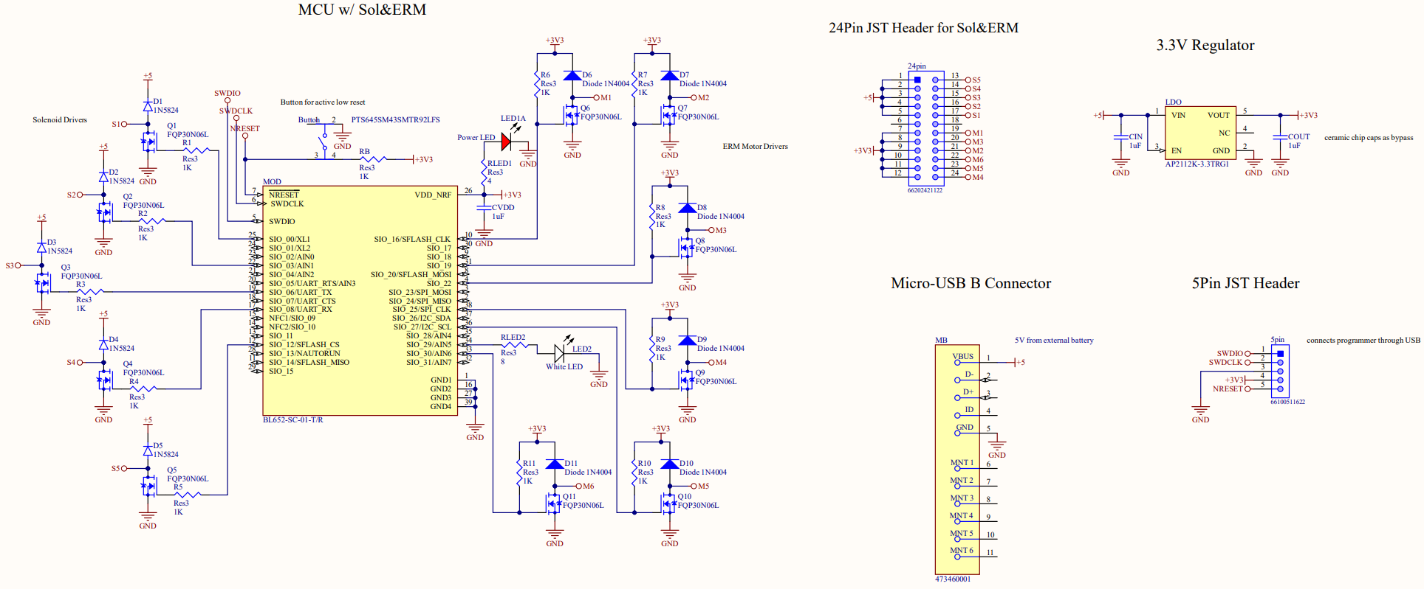
Custom PCB - Schematic
Notes:
Full schematic
Anthony

Slide 18
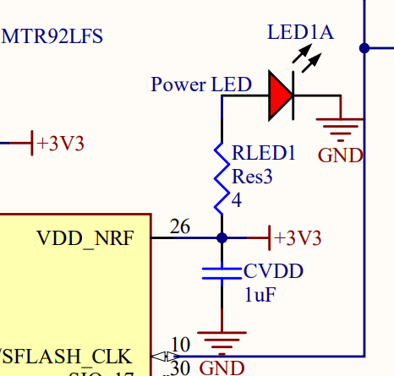
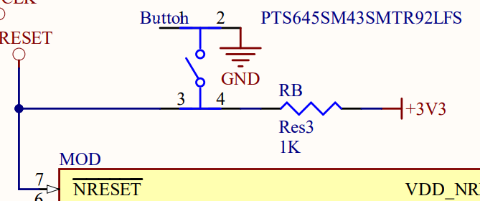
Schematic - MCU
Notes:
Left - circuit for reset
Right - circuit for power LED
Anthony

Slide 19
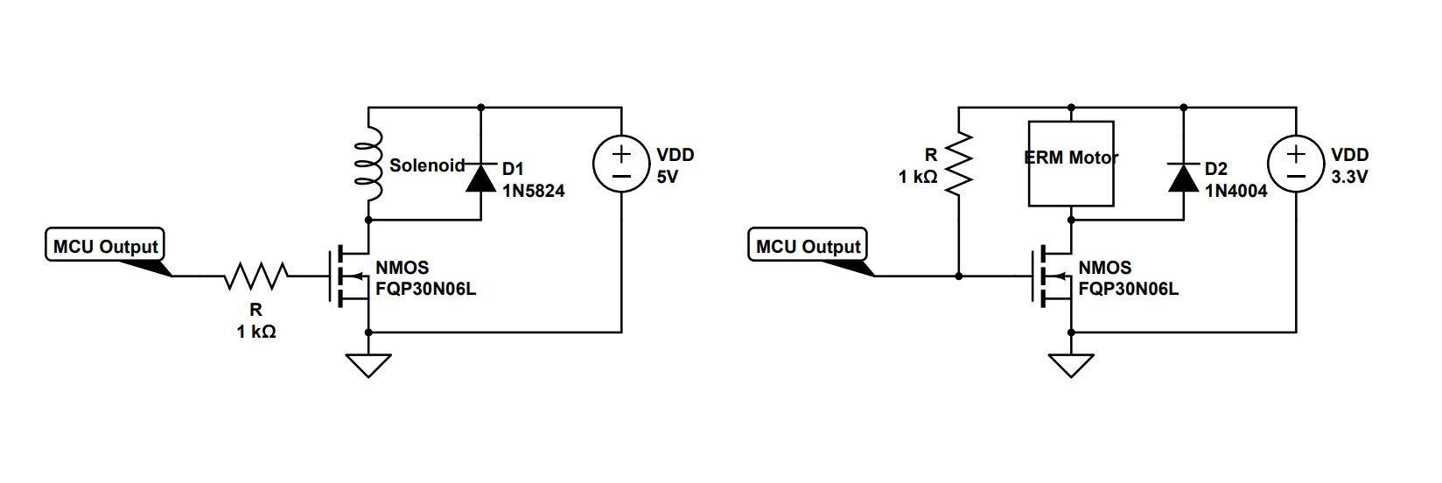
Schematic - ERM and Solenoids
Notes:
Circuit for a motor and a solenoid
Anthony

Slide 20
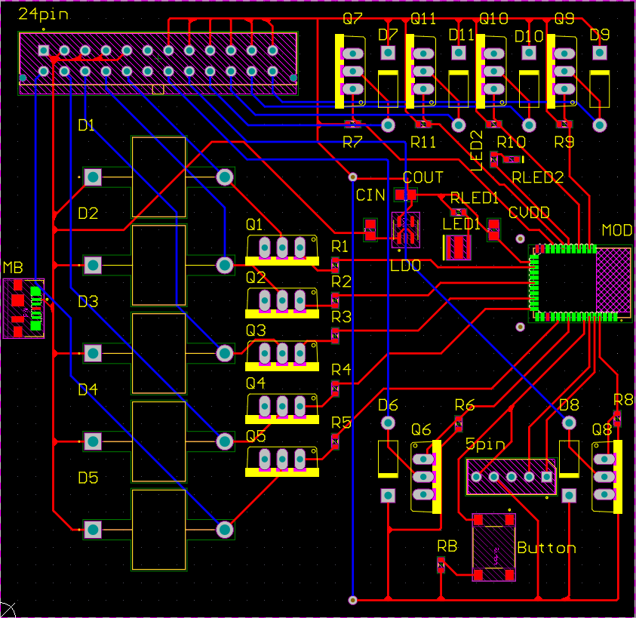
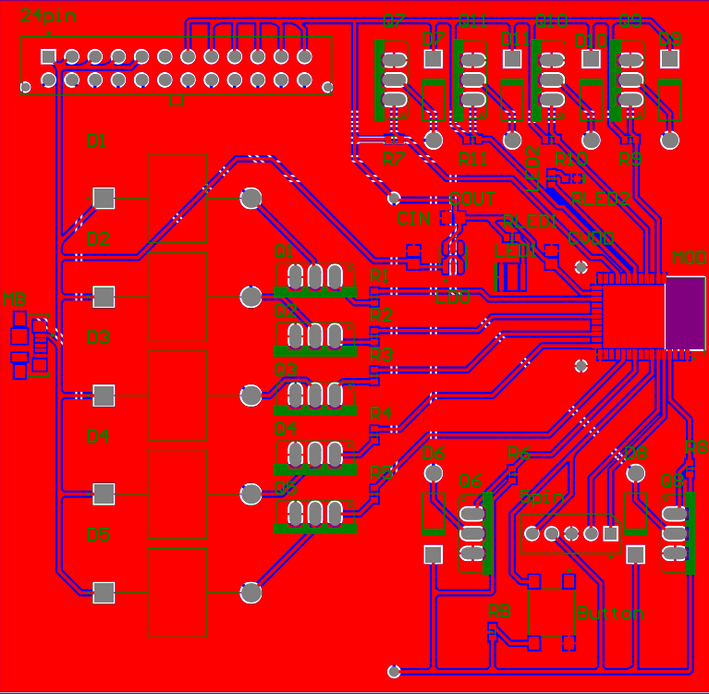
Custom PCB - Layout
Notes:
Left - layout of both layers before ground pours
Right - fully stacked layout with ground pours
Anthony

Slide 21
FPR deliverables
Fingers are appropriately stopped when grabbing objects
Create demo that shows fingers conforming to other shapes
Such as holding a drill
Transition from Adafruit Feather to custom PCB
Clean up wires and design
Stress test our hardware
Resolve any bugs that may occur
Verify our system specifications
Notes:
Jonathan
Here are our deliverables for FPR. First, we want to make sure our end product gives our desired haptic feedback.As you saw in the demo we gave today, we have the integrated system but we do not yet have it on the glove.
Once we have it on the glove, we will need to fine tune some parameters so that the solenoids not only activate, but activate with enough time for the solenoids to stop the string. And therefore giving the feeling of grasping objects.
In addition to that, we plan to add more objects to the virtual scene. Right now we only have a simple cube. Adding more shapes and objects will make the demonstration more interesting and will give us an opportunity to show that our system can independently control each finger.
We will also transition from the Feather that we are currently using to our custom PCB. We have our pcb printed and tested. As of now, we don’t see any issues with the current PCB we have, however, if we run into any issues, we may have to redesign and order a new PCB.
Once all of that is done, we will be done with all the technical parts of the project. The last things we will have to do is to stress test our system, resolve any outlying issues, and check offf our specifications.

Slide 22
Verifying Requirements
Wireless system
No testing needed
Rechargeable battery of minimum 1 hour of life
Calculate theoretical power consumption
Run the system for 1 hour with simulated workload
Single glove with system weighs no more than 2lbs
Weigh integrated system
Braking system and vibration activates within 100ms of seeing the object being touched in virtual world
Add BLE ACK and measure time from when Unity detects collision to when the BLE ACK is received
Braking system able to withstand 20N of pulling force from finger-bending strength
Activate the solenoid and attach a 20N weight to check that the system doesn’t break
Notes:
Jonathan
This is how we plan to verify our system requirements that we set. We already have a wireless system because we are using BLE.
To test the battery life, we plan on calculating the theoretical power consumption. One way we could do this is to see how much power each solenoid and ERM motor uses per activation. Then calculate how many activations our battery can handle
To verify the weight we will weigh our end system.
To verify the latency, use Ack messages. We will measure the detection time and ACK received time.
This is not very scientific but we could also go by feeling. We were informed that 100ms is very generous. As long as we dont notice the delay, we will assume that the latency is less than 100ms. If it is longer than 100ms, it should be notable to the user
For the last point, we will attach a 20N weight to one of the fingers. If the string does not break and our solenoid does not unlatch from the gear, our system is sturdy enough to handle heavy use.

Slide 23
Hardening
If there are insecure connectors, look at locking connector alternatives, or glue or soldering to keep them in place
Replace fragile wires (e.g. the ERM motor wires) with more robust wires
If mechanical components are not secure, route them with guides or attach to the glove in more permanent manner
Shake our system, test it multiple times so nothing breaks last minute
Notes:
Jonathan
These are just some final steps that we will need to do. Basically we will need to make sure all of the wires are secured in place and nothing is loose. The strings are currently all over the place, we plan to route these strings along the hand and fingers. Once that is all done, we will stress test our system. We will be rough with our system, shaking our system, making sure there are no loose connections and everything is robust enough that nothing will break last minute.

Slide 24
Gantt Chart
TODO
Notes:
Alex

Slide 25
CDR-to-FPR Individual Responsibilities
Alex- 3-D printing of glove design and finishing physical build of glove (PCB casing, wire management)
Jonathan- Virtual World interactions
Cameron- Perform tests to verify specs are met
Anthony- Design revised PCB schematic and layout
Notes:
Alex

Slide 26
Project Expenditures
Total Shipping Cost for (all individual orders): $82.66
Total Cost: $338.66
Notes:
Alex

Slide 27
Thank you!
Questions?

